Slide 1






A DATA ANALYSIS PROJECT
Electrical Motor Fault Analysis and Prediction
- Rohitha Aiswarya Dora Hanumanthu
Github Repo Link

Slide 2
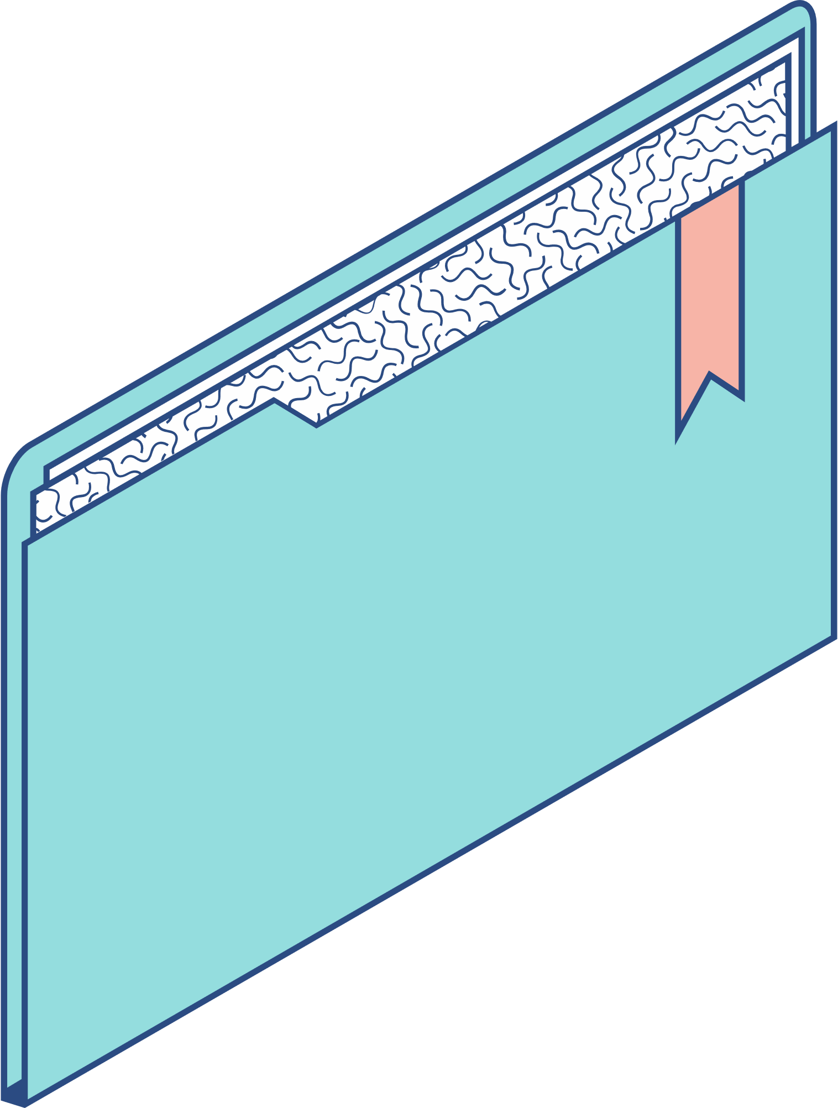
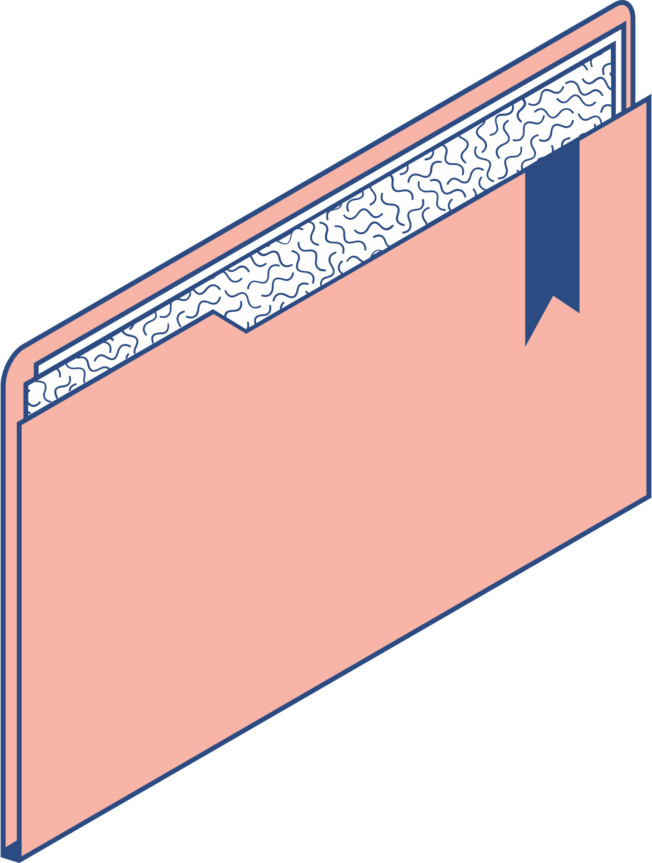
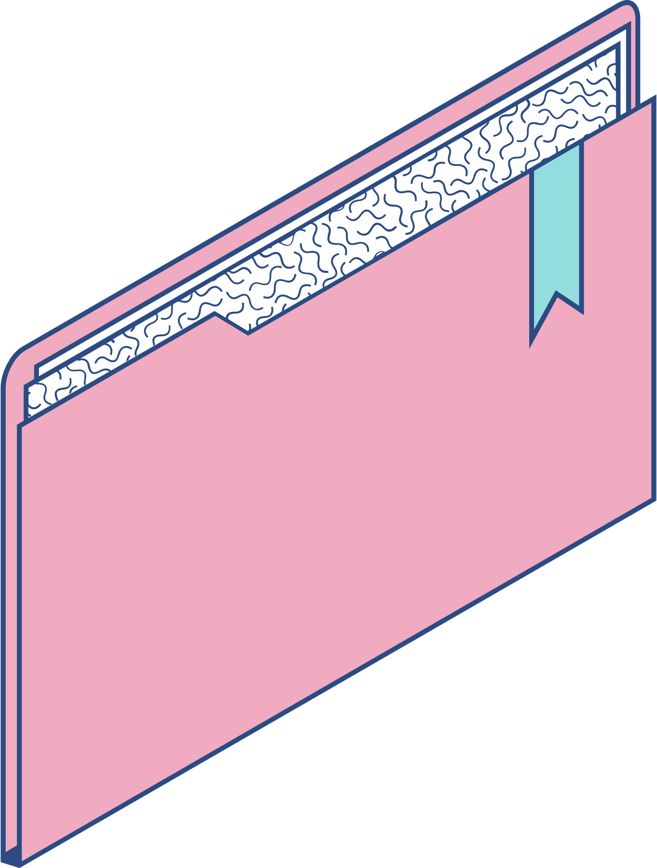
Agenda
KEY TOPICS DISCUSSED IN THIS PRESENTATION
Introduction Challenges in Electrical Motor Operation Data Collection and Preprocessing Exploratory Data Analysis Feature Engineering Fault Prediction Models Model Evaluation Benefits of Fault Analysis and Prediction Conclusion

Slide 3

INTRODUCTION
Welcome to the presentation on "Electrical Motor Fault Analysis and Prediction."
In this presentation, we will explore the crucial aspects of electrical motor fault analysis and how predictive maintenance can help in preventing costly breakdowns and improving operational efficiency.
Electrical motors are an integral part of various industries, from manufacturing to transportation, making their reliable operation essential for seamless productivity.

Slide 4


"In the vast universe of data, lies the hidden power to predict machine failures and unlock productivity."
Dataset: "We have a dataset consisting of various operational parameters and failure indicators." Goal: "Our mission is to analyze the data, engineer meaningful features, and build models to foresee machine failures."

Slide 5

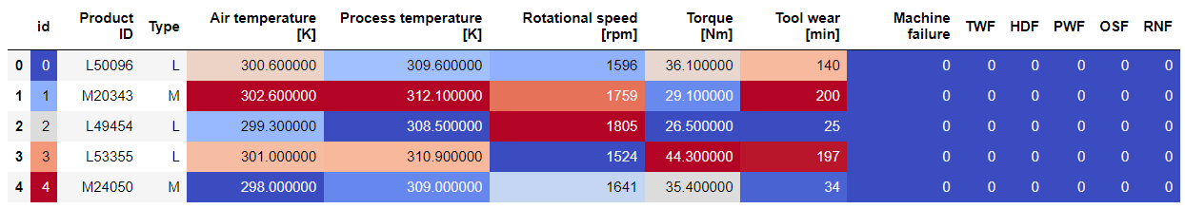
Initially the Dataset looked like this
Shape of the Dataset:
( 136429, 14)
135429 rows and 14 columns

Slide 6
Electrical motors face numerous challenges during operation
INCLUDING:
TWF - Tool wear Failure
HDF - Heat Dissipation Failure
PWF - Power Failure
OSF - Overstrain Failure
RNF - Random Failure

Slide 7
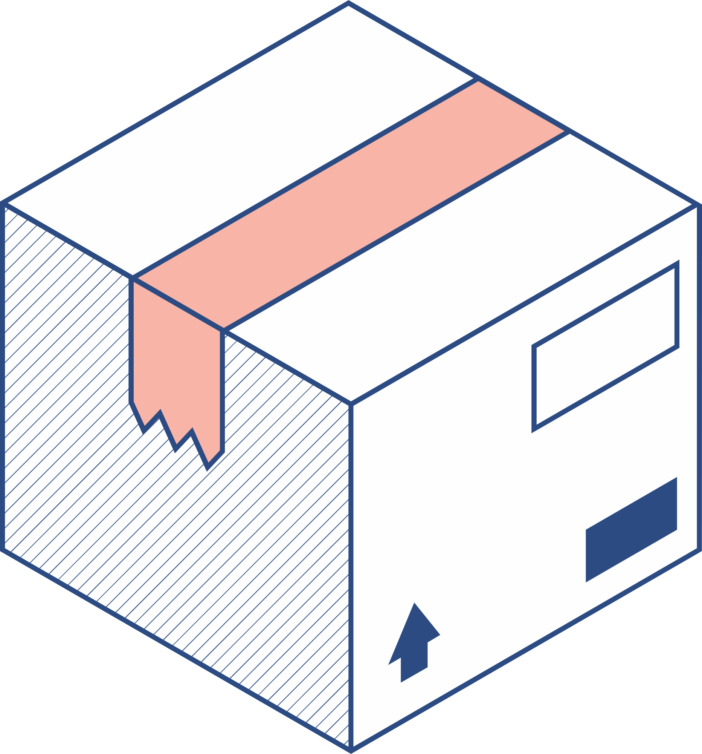


Data Collection and Preprocessing
Data collection is crucial for understanding motor behavior and identifying potential faults. Data is collected from Kaggle.com Data preprocessing involves cleaning and normalizing the collected data to remove noise and ensure consistency.

Slide 8
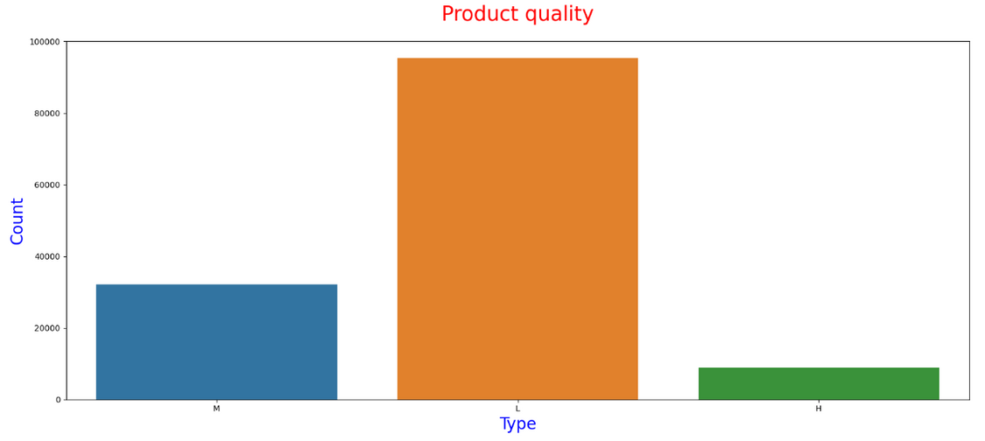
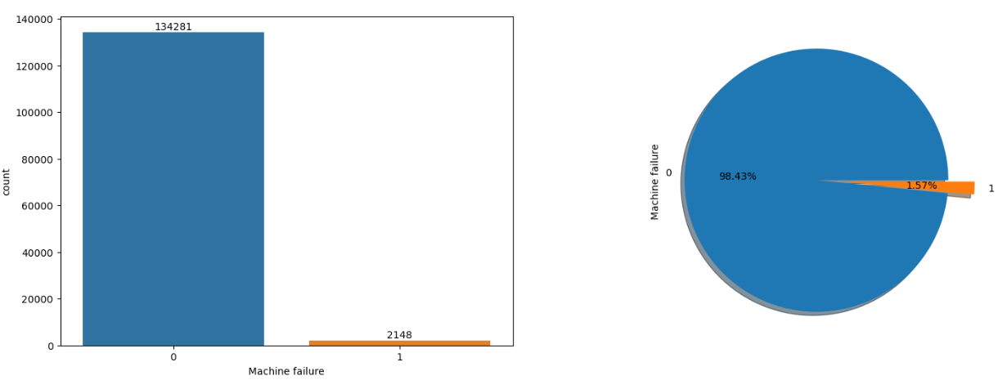
Product Quality
Exploratory Data Analysis
We can see the data distribution in accordance with product quality and Machine Failure.
Product Quality is of three types L- low, M- medium, and H- high.
Machine Failure is set then the value is 1, else 0. Machine Failure is set whenever atleast one fault mode is set.
Machine Failure

Slide 9
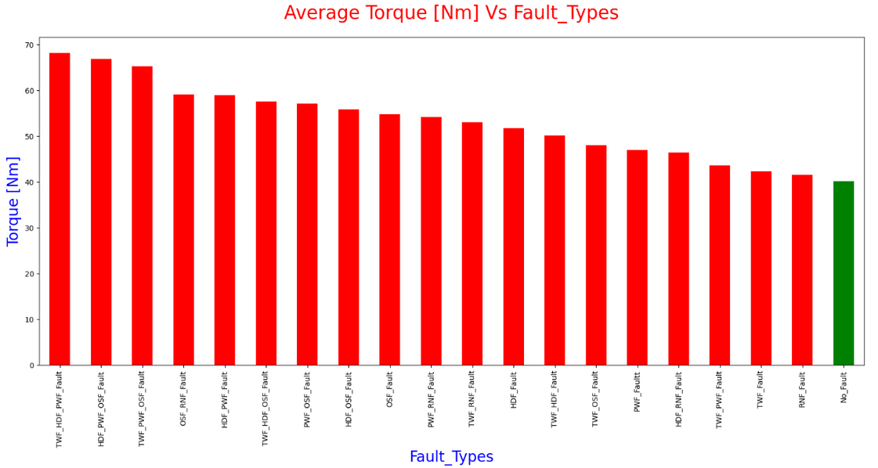
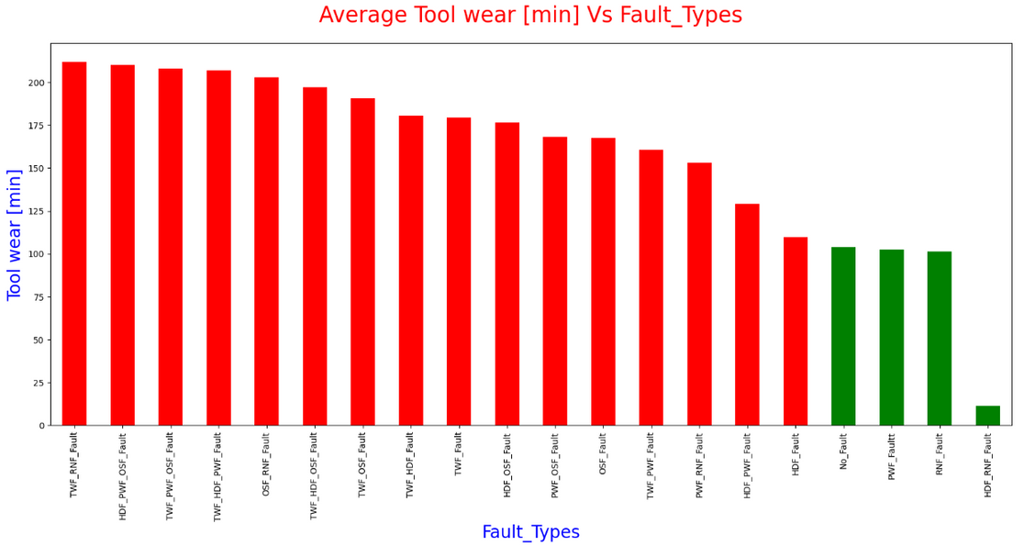
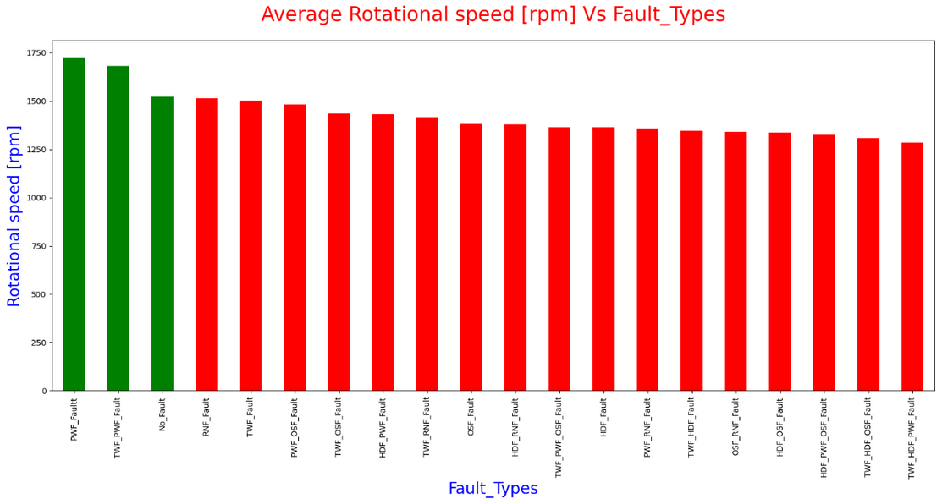
Showcasing the behaviour of Fault_Types attribute in accordance with various factors such as Torque, Tool Wear and Rotational speed.

Slide 10
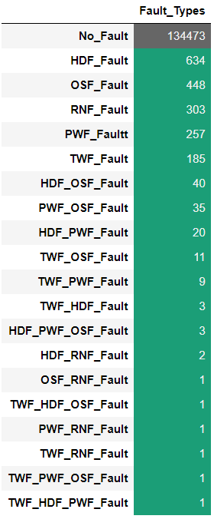
Feature Engineering
What is Feature Engineering
Feature engineering is the process of selecting and transforming relevant data attributes (features) for fault analysis.
Added a new feature (attribute) to the dataset which indicates all the failure modes available using binary digits (0 and 1) and later converted into required string. Carefully engineered features provide valuable insights into motor health and performance.

Slide 11
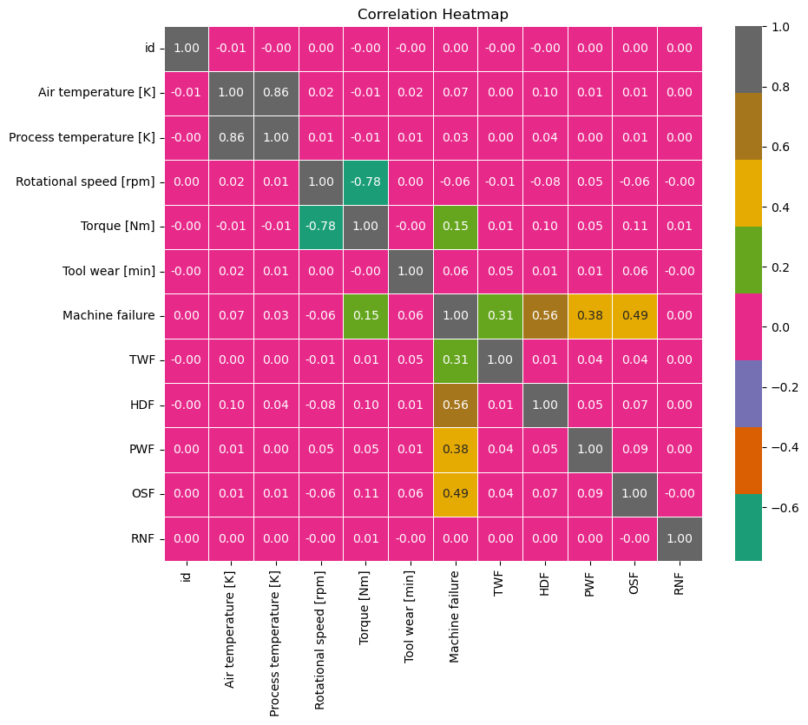
Correlation Analysis
Correlation provides valuable insights into how different features interact with each other.
The heatmap showcases the intensity of relationships between different features.

Slide 12
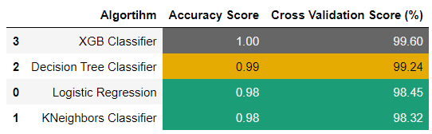
Fault Prediction Models
4 models were used in the classification
Logistic Regression
Classification Models
XGB Classifier
KNeighbors Classifier
Decision Tree Classifier

Slide 13



Benefits
Early detection and prevention of motor failures, reducing unplanned downtime.
Optimized maintenance schedules, lowering maintenance costs.
Improved safety and productivity through reliable motor operation.

Slide 14

Conclusion:
Electrical motor fault analysis and prediction are crucial for efficient industrial operations.
Proactive maintenance based on data-driven insights can revolutionize how we manage motor health and performance.
Through our data analysis, we were able to extract meaningful insights about the factors that contribute to machine failure. We explored the impact of different features like "Torque [Nm]", "Tool wear [min]", and "Rotational speed [rpm]" on the occurrence of machine failure.
We identified unique fault types and their relationships with these features, shedding light on potential patterns and warning signs.

Slide 15

THANK YOU
Github Repo Link
H. Rohitha Aiswarya

